Slide 1

Recommendation System
A Case study on LinkedIn Job Recommendation System
Hemavardhan Velamakanni AP22110010458

Slide 2
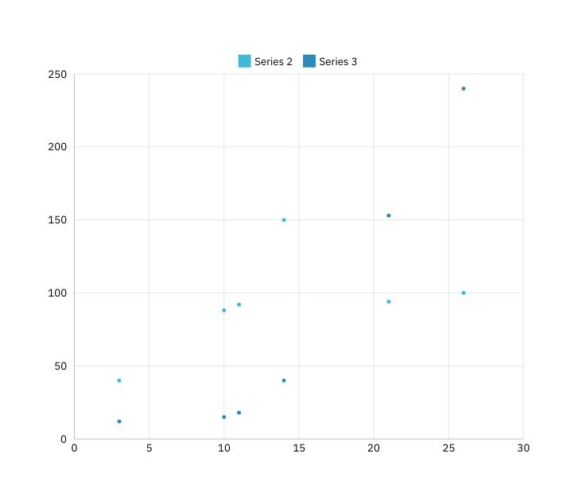
How do we Approach?
Recommendation system Types
Data Collection and Preproccesing
Content Based Filtering
Moddel Selection
Collaborative Based Filtering
Evaluation Metrix
How Does Collabartive System Help user in Linkedin
Result Analysis
Limitations
Case Study
Problem Definition
Conclusion

Slide 3
Recommendation System
A recommendation system is an AI-driven tool designed to help users discover items or content that align with their interests, needs, or behaviors. In digital platforms, recommendation systems enhance user experiences by personalizing suggestions, allowing users to efficiently find relevant information in vast datasets.
In the context of the case study LinkedIn's job recommendation system, the purpose is to recommend job opportunities that match a user’s skills, experience, and career goals. By leveraging various data, such as user profiles, past job interactions, and similarity in skills or industries, LinkedIn’s recommendation system can make the job-seeking experience more relevant, engaging, and efficient.

Slide 4
Types of Recommendation System
Content-Based Filtering: Recommends items similar to those a user has interacted with, based on attributes like skills or industry.
Collaborative Filtering: Suggests items liked by similar users, leveraging patterns in user behavior and interactions.
Hybrid Systems: Combines content-based and collaborative approaches to improve recommendation relevance and balance.
Knowledge-Based Systems: Recommends based on specific user criteria, such as required qualifications, for tailored matches.
Deep Learning Models: Uses neural networks to capture complex patterns, providing highly personalized and adaptive recommendations.
For context lets discuss about Content and Collaborative Filtering in further slides

Slide 5
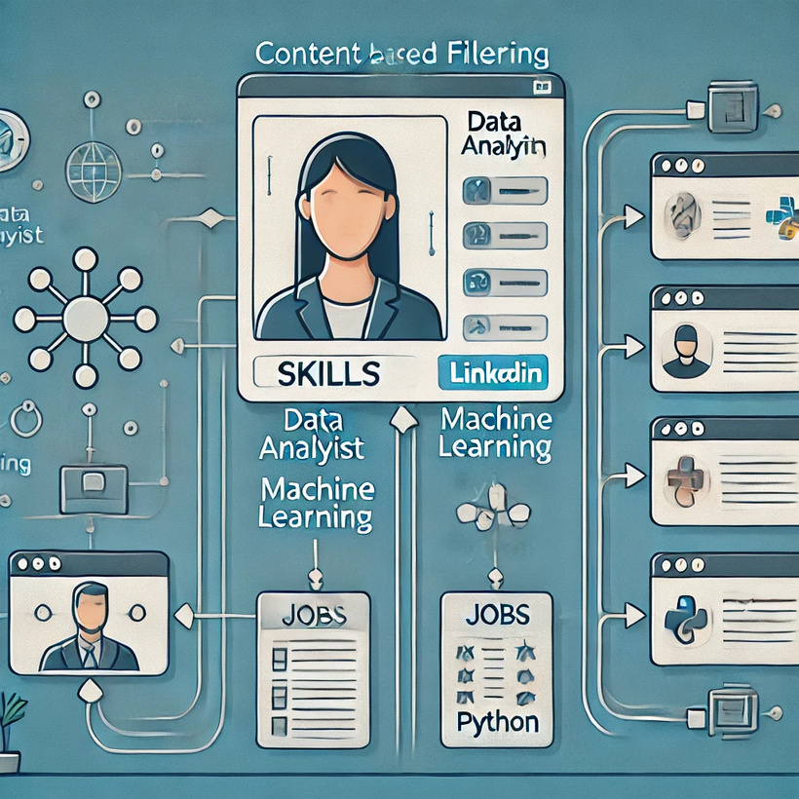
Content-Based Filtering
Content-Based Filtering suggests items tailored to a user’s profile and the characteristics of content they have previously enjoyed. It evaluates attributes—such as skills, job titles, or industry keywords—to identify similar content. For instance, on LinkedIn, this method recommends jobs that correspond with the skills outlined in a user's profile, ensuring that the suggestions are pertinent to their professional experience. Content-based techniques are especially beneficial for new users, as they depend mainly on specific profile information rather than on wider user interactions.

Slide 6
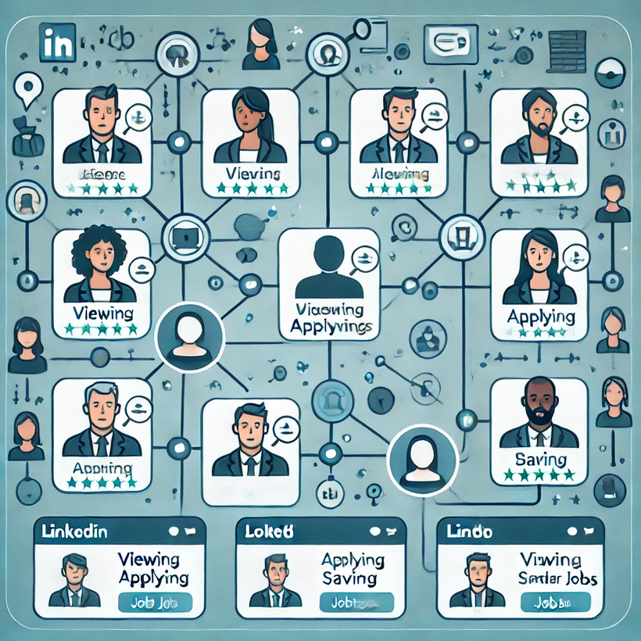
Collaborative Filtering
Collaborative Filtering suggests items by analyzing the behaviors and preferences of users with similar characteristics. Instead of depending solely on an individual user’s profile, it utilizes patterns from user interactions, such as likes, clicks, or applications, to recommend relevant job opportunities. For instance, if users with comparable backgrounds apply for specific positions, those jobs are more likely to be recommended to others within that same user group. This approach is effective in uncovering hidden patterns and trends in user interactions.

Slide 7
How Does Collaborative Filtering Help Linkedin Recommendations
Collaborative Filtering enables LinkedIn to suggest job opportunities by examining user interactions—like applying for, viewing, or saving jobs—and identifying patterns among users with comparable behaviors. For instance, if individuals with data science backgrounds often explore or apply for specific positions, LinkedIn can recommend those roles to other data science users, even if they haven't encountered them before. This method reveals concealed job preferences by linking users through shared interests, thereby improving the relevance of job suggestions and boosting user engagement.

Slide 8
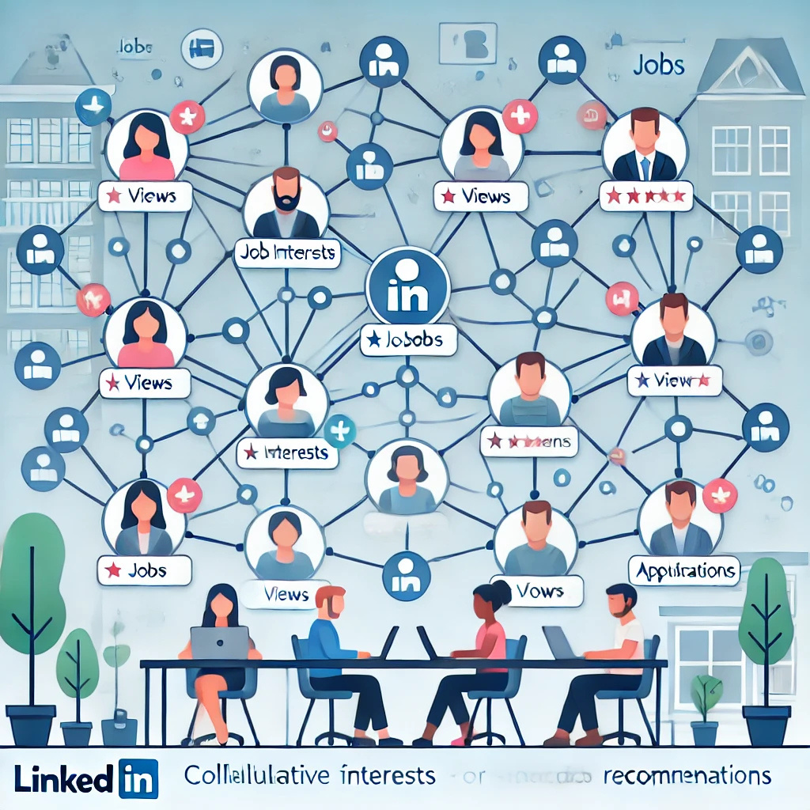

Slide 9
Lets discuues about the Case study
Introduction:
LinkedIn’s job recommendation system plays a crucial role in connecting millions of users with job opportunities that align with their skills, experience, and career aspirations. In a landscape filled with diverse industries, locations, and levels of expertise, personalized recommendations enhance the efficiency and engagement of the job search process. This case study explores how LinkedIn utilizes machine learning—specifically content-based and collaborative filtering techniques—to deliver pertinent job suggestions. By examining user profiles, interactions, and job data, LinkedIn’s recommendation system seeks to optimize job matching, enabling users to uncover career opportunities that fit their unique backgrounds and interests.

Slide 10
Problem without a proper collaborative Filtering
Limited Personalization: Content-based filtering relies on a user’s profile alone, which may miss relevant jobs that similar users have found valuable but aren’t directly reflected in their profile.
Difficulty Capturing Trends: Without collaborative filtering, the system can’t detect popular jobs or in-demand skills among peers, making recommendations less timely and adaptable to trends.
Reduced Diversity: Content-only recommendations can be too narrow, suggesting only exact matches, like data analyst roles for a data science user, missing related fields.

Slide 11
Lets go Through the CASE!
In a system such as Collaborative Filtering Recommendation, several steps must be followed to generate recommendations, including data preparation, selecting an appropriate metric, implementing the algorithm, and evaluating the outcomes. Platforms like LinkedIn execute these processes meticulously to ensure precise results.
For recommendations on LinkedIn, we can utilize the Cosine Similarity metric to determine similarity, which comes into play after data preparation is complete and all necessary libraries are in place.
Let's proceed step by step!

Slide 12
STEP 1: Data Preparation
All we need is a CSV or Excel file to organize and utilize our data. However, many large-scale platforms, such as LinkedIn, employ a blend of advanced data storage solutions and architectures to manage the immense volumes of data produced by their users. They work with various databases, including relational databases and NoSQL databases. For data warehousing, they rely on Apache Hive, while real-time data preprocessing is handled by Apache Kafka, among other tools. This approach ensures that data preprocessing occurs with a dataset focused on user-item interactions.

Slide 13
STEP 2:User-Item Interaction Matrix
Convert the dataset into a user-item matrix where rows represent users and columns represent items.
Rows: Represent individual users.
Columns: Represent items(Jobs)
Entries(Cells):Each entry in the matrix indicates the interaction or relationship between a user and item
Since LinkedIn is a professional networking site, users rarely provide explicit ratings on jobs, connections, or content.
Job Interactions: Viewing, saving, or applying for jobs indicates interest in certain roles or industries.
Content Engagement: Liking, sharing, or commenting on posts or articles suggests user interest in particular topics or fields.

Slide 14
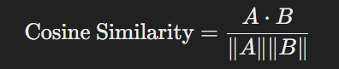
STEP 3:Choose a Similarity Metric
By utilizing cosine similarity in these scenarios, LinkedIn is able to offer tailored job recommendations, suggest connections, and enhance content discovery. This approach is especially advantageous because it effectively manages sparse data, such as user interactions, while prioritizing the direction of the data over its magnitude. This makes cosine similarity particularly fitting for the high-dimensional spaces commonly found in recommendation systems.
LinkedIn primarily uses cosine similarity metric in its recommendation system to determines how closely related users or items are based o interaction.

Slide 15
STEP 3:Implement the Recommendation Algorithm
LinkedIn’s recommendation algorithm is a sophisticated system designed to deliver personalized suggestions for jobs, connections, content, and skills. Here’s an outline of how LinkedIn implements its recommendation algorithms, leveraging a combination of collaborative filtering, content-based filtering, and machine learning techniques:
Data Collection and Pre-processing
Feature Engineering
Collaborative Filtering Techniques
Filtering
Machine Learning Algorithms
Personalization and Real-Time Processing
Cosine Similarity and Other Similarity Metrics
Evaluation and Optimization

Slide 16
STEP 4: Evaluate the Recommendations
Evaluate the Performance:
Using metrics like Mean Absolute Error (MAE), Precision, Recall, or F1 Score to evaluate the recommendations.
May need a test set for evaluation, which could be created by splitting the original dataset.
LinkedIn recommendation system is evaluated using a combination of offline metric and accuracy ,online Metrix for real time relevance, and user feedback for qualitative insights. This multi-faceted evaluation helps LinkedIn continuously improve its algorithms, making them more accurate, relevant and engaging users.

Slide 17
Result Analysis and Limitations
The effectiveness of LinkedIn's recommendation system can be assessed through metrics like Precision, Recall, and F1-Score, but it faces several limitations:
Data Sparsity: Limited interactions hinder profile accuracy for users.
Cold Start Problem: New users/items lack interaction data for accurate recommendations.
Scalability Challenges: Growing user base complicates system scaling.
Overfitting to Past Behavior: Reliance on past behavior can lead to stale, less diverse recommendations.
Bias and Fairness Issues: Algorithmic bias may perpetuate inequalities in job recommendations.
Lack of Contextual Understanding: Static profiles fail to capture changing user preferences over time.

Slide 18
Conclusion
In summary, LinkedIn's recommendation system is vital for boosting user engagement by offering tailored job suggestions and connection opportunities via collaborative filtering methods. Although it successfully assesses user interactions to provide pertinent recommendations, it faces challenges like data sparsity, cold start problems, and algorithmic bias that need to be resolved to enhance its precision and relevance.
By consistently improving the system and utilizing user feedback, LinkedIn can further support professionals in their career paths, cultivating a more interconnected and vibrant professional network.

Slide 19


